Slide 1
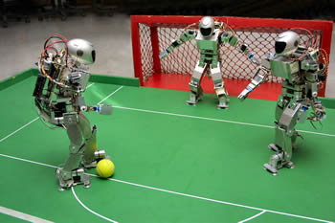
Chapter 5: Adversarial Search
In which we examine the problems that arise when we try to plan ahead in a world where other agents are planning against us.

Slide 2
Adversarial Search
Multi-agent environment:
any given agent needs to consider the actions of other agents and how they affect its own welfare
introduce possible contingencies into the agent’s problem-solving process
cooperative vs. competitive
Adversarial search problems: agents have conflicting goals -- games

Slide 3
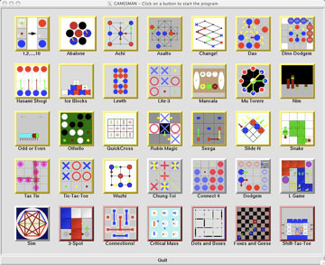
Games vs. Search Problems
"Unpredictable" opponent
specifying a move for every possible opponent reply
Time limits
unlikely to find goal, must approximate

Slide 4
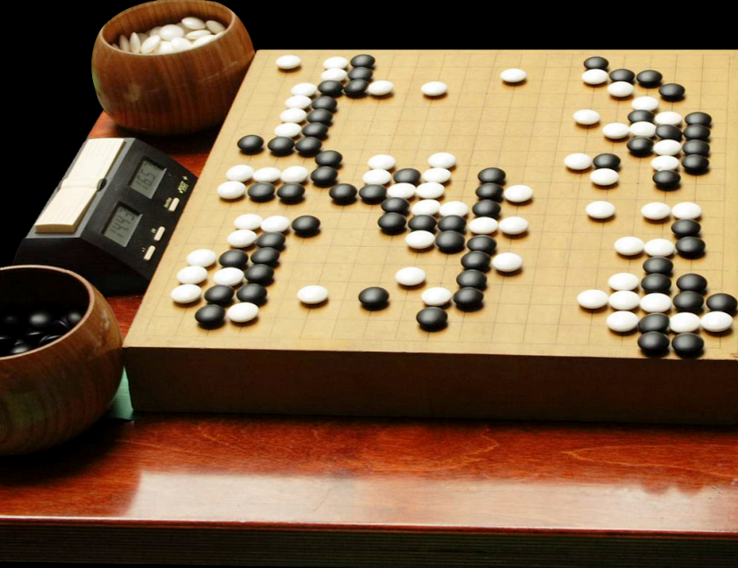
AI and Games
In AI, “games” have special format:
deterministic, turn-taking, 2-player, zero-sum games of perfect information
Zero-sum describes a situation in which a participant’s gain or loss is exactly balanced by the losses or gains of the other participant(s)
Or, the total payoff to all players is the same for every instance of the game (constant sum)
Go! 围棋

Slide 5
Game Problem Formulation
A game with 2 players (MAX and MIN, MAX moves first, turn-taking) can be defined as a search problem with:
initial state: board position
player: player to move
successor function: a list of legal (move, state) pairs
goal test: whether the game is over – terminal states
utility function: gives a numeric value for the terminal states (win, loss, draw)
Game tree = initial state + legal moves

Slide 6
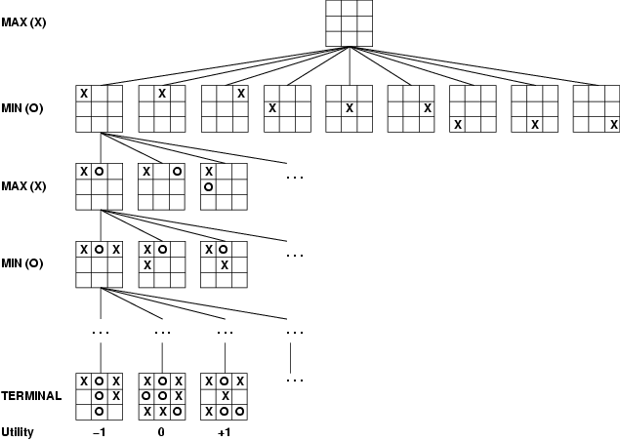
Game Tree (2-player, deterministic)
Utility value

Slide 7
Optimal Strategies
MAX must find a contingent strategy, specifying MAX’s move in:
the initial state
the states resulting from every possible response by MIN
E.g., 2-ply game (the tree is one move deep, consisting of two half-moves, each of which is called a ply):
MAX
3
MIN
3
2
2
MAX
3
12
8
2
4
6
14
5
2

Slide 8
Minimax Value
Perfect play for deterministic game, assume both players play optimally
Idea: choose move to position with highest minimax value = best achievable payoff against best play
if n is a terminal state
if n is a MAX node
if n is a MIN node

Slide 9
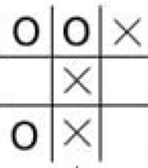
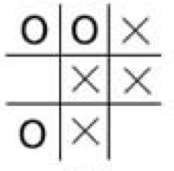
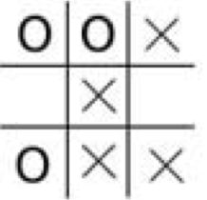
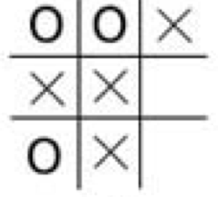
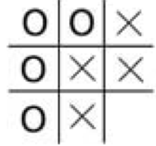
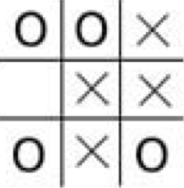
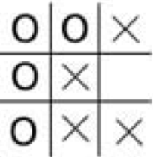
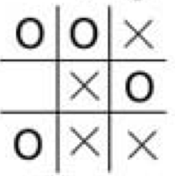
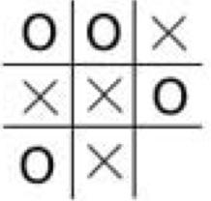
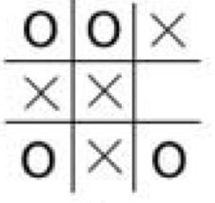
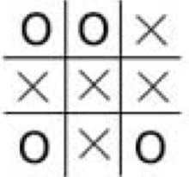
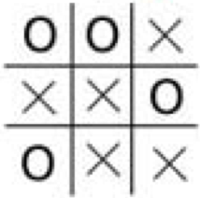
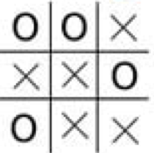
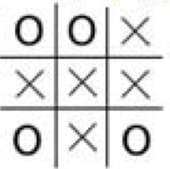
A Partial Game Tree for Tic-Tac-Toe

Slide 10
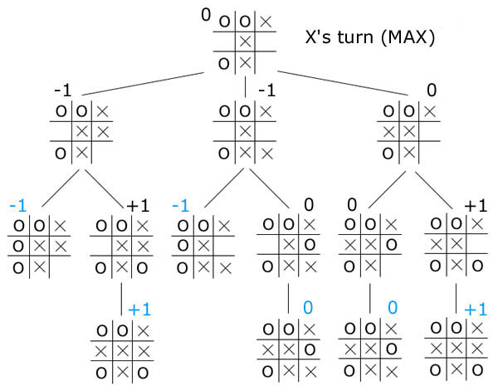
A Partial Game Tree for Tic-Tac-Toe
O’s turn (MIN)
X’s turn (MAX)
by Yosen Lin

Slide 11
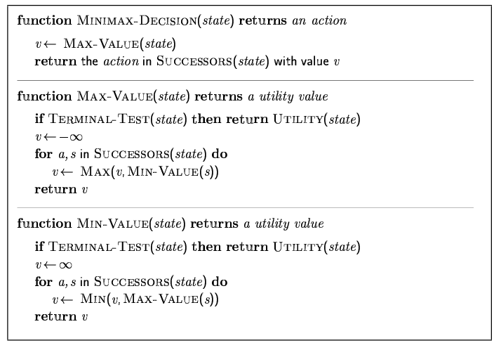
Minimax Algorithm

Slide 12
Minimax with Tic-Tac-Toe
Work on board.
Walk through a real tic-tac-toe program.

Slide 13
Analysis of Minimax
Optimal play for MAX assumes that MIN also plays optimally, what if MIN does not play optimally?
A complete depth-first search?
Yes
Time complexity?
O(b^{m})
Space complexity?
O(bm) (depth-first exploration)
For chess, b ≈ 35, m ≈ 100 for "reasonable" games → exact solution completely infeasible

Slide 14
Optimal Decisions for Multiplayer Games
Extend minimax idea to multiplayer
A
(1,2,6)
B
(1,2,6)
(1,5,2)
C
(1,2,6)
(6,1,2)
(1,5,2)
(5,4,5)
A
(1,2,6)
(4,2,3)
(6,1,2)
(7,4,1)
(5,1,1)
(1,5,2)
(7,7,1)
(5,4,5)

Slide 15
Interesting Thoughts
Multiplayer games usually involve alliances, which can be a natural consequence of optimal strategies
If the game is non zero-sum, collaboration can also occur
For example, a terminal state with utilities <Va = 1000, Vb = 1000>
The optimal strategy is for both players to do everything possible to reach this state

Slide 16
α-β Pruning
The number of game states with minimax search is exponential in the # of moves
Is it possible to compute the correct minimax decision without looking at every node in the game tree?
Need to prune away branches that cannot possibly influence the final decision

Slide 17
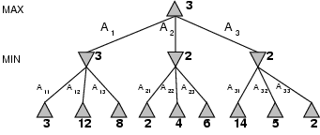
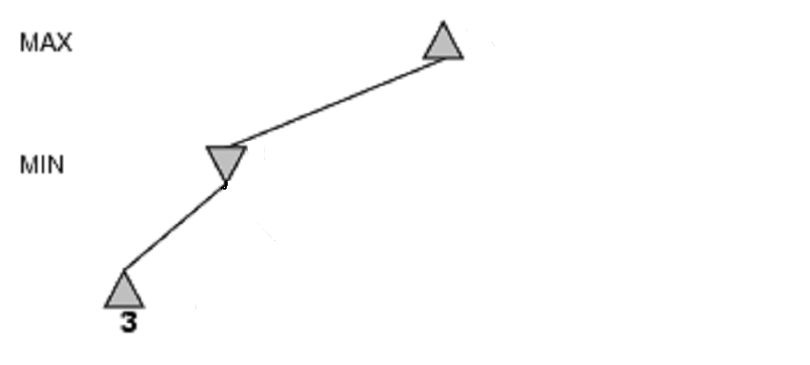
α-β Pruning Example
[-∞,+∞]
[-∞, 3]

Slide 18
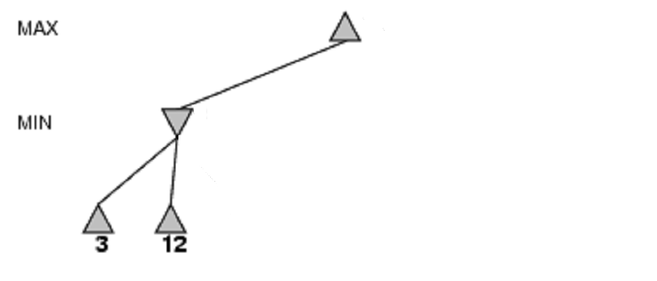
α-β Pruning Example
[-∞,+∞]
[-∞, 3]

Slide 19
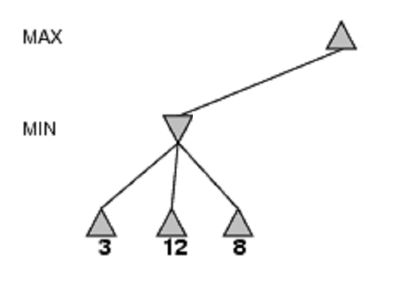
α-β Pruning Example
[3,+∞]
[3, 3]

Slide 20
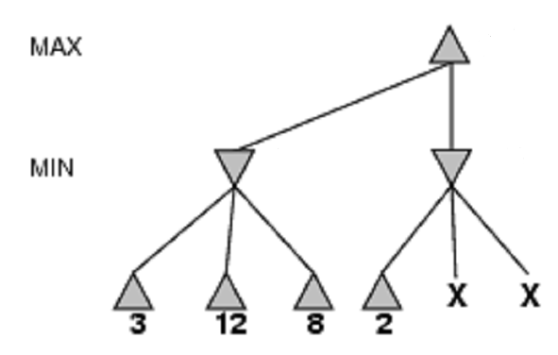
α-β Pruning Example
[3,+∞]
[3, 3]
[-∞, 2]

Slide 21
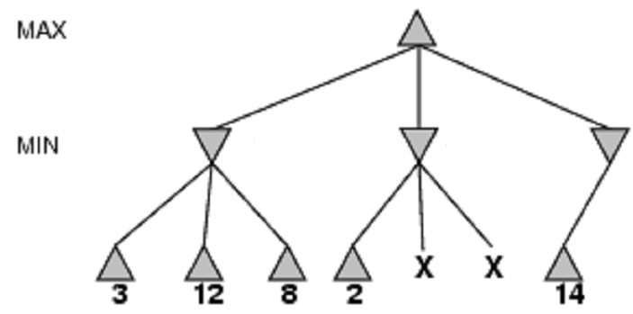
α-β Pruning Example
[3, 14]
[3, 3]
[-∞, 2]
[-∞, 14]

Slide 22
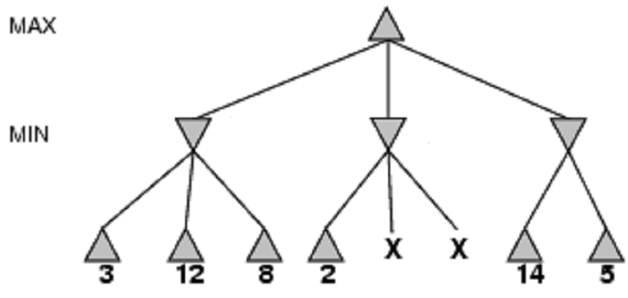
α-β Pruning Example
[3, 5]
[3, 3]
[-∞, 2]
[-∞, 5]

Slide 23
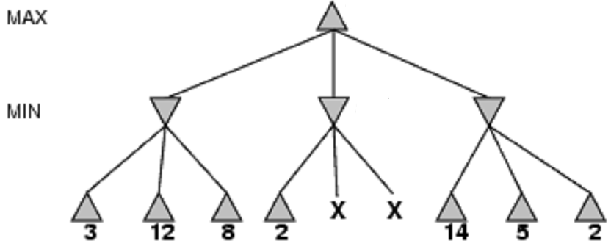
α-β Pruning Example
[3, 3]
[3, 3]
[-∞, 2]
[2, 2]

Slide 24
A Simple Formula
where z ≤ 2
The value of the root and hence the minimax decision are independent of the values of pruned leaves x and y

Slide 25
α-β Pruning Exercise
MAX
MIN
MAX
2
5
8
1
2
7
3
6
9

Slide 26
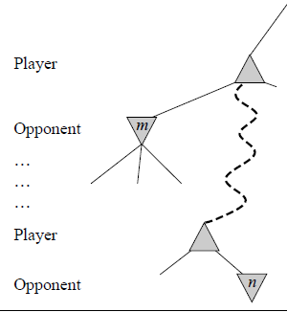
Basic Idea of α-β
Consider a node n such that Player has a choice of moving to
If Player has a better choice m either at the parent of n or at any choice point further up, then n will never be reached in actual play
α-β pruning gets it name from the two parameters that describe bounds on the backed-up values

Slide 27
Definitions of α and β
α = the value of the best (highest-value) choice we have found so far at any choice point along the path for MAX
β = the value of the best (lowest-value) choice we have found so far at any choice point along the path for MIN
α-β search updates the values of α and β as it goes along and prunes the remaining branches at a node as soon as the value of the current node is worse than the current α or β for MAX or MIN respectively

Slide 28
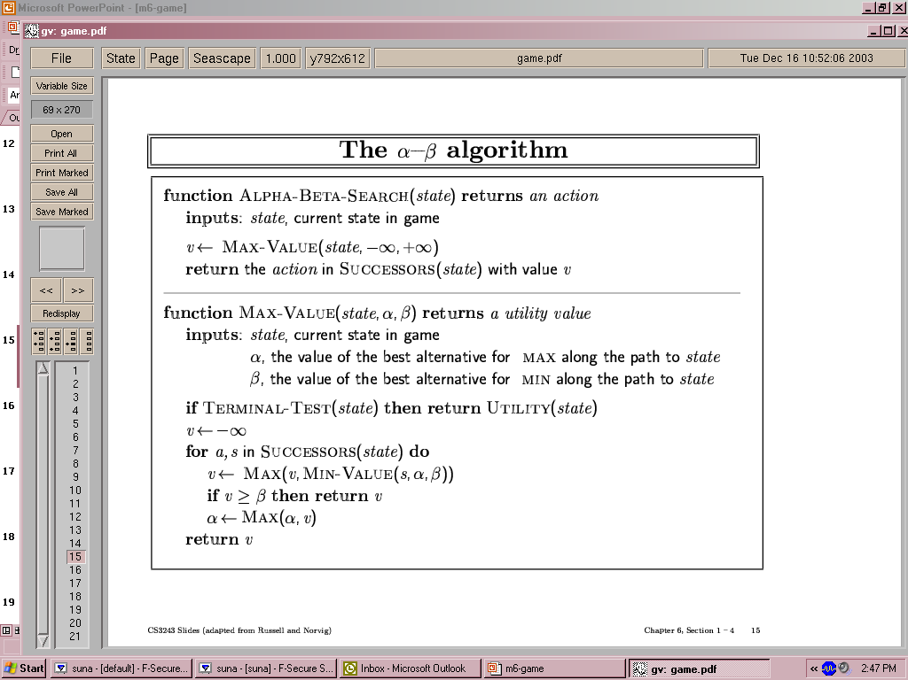
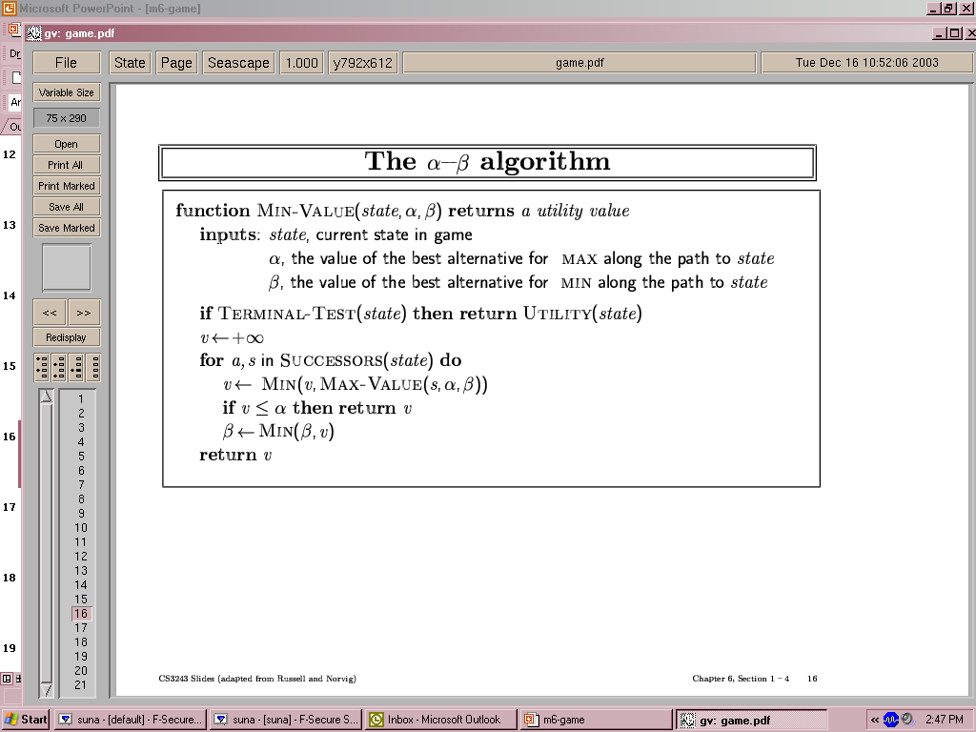
The α-β Algorithm

Slide 29
Now, Trace The Behavior
MAX
3
A
MIN
3
B
2
C
2
D
3
12
8
2
4
6
14
5
2

Slide 30
Analysis of α-β
Pruning does not affect final result
The effectiveness of alpha-beta pruning is highly dependent on the order of successors
It might be worthwhile to try to examine first the successors that are likely to be best
With "perfect ordering," time complexity = O(b^{m/2})
effective branching factor becomes
For chess, 6 instead of 35
it can look ahead roughly twice as far as minimax in the same amount of time
Ordering in chess: captures, threats, forward moves, and then backward moves

Slide 31
Random Ordering?
If successors are examined in random order rather than best-first, the complexity will be roughly O(b^{3m/4})
Adding dynamic move-ordering schemes, such as trying first the moves that were found to be best last time, brings us close to the theoretical limit
The best moves are often called killer moves (killer move heuristic)

Slide 32
Dealing with Repeated States
In games, repeated states occur frequently because of transpositions --
different permutations of the move sequence end up in the same position
e.g., [a1, b1, a2, b2] vs. [a1, b2, a2, b1]
It’s worthwhile to store the evaluation of this position in a hash table the first time it is encountered
similar to the “explored set” in graph-search
Tradeoff:
Transposition table can be too big
Which to keep and which to discard

Slide 33
Imperfect, Real-Time Decisions
Minimax generates the entire game search space
Alpha-beta prunes large part of it, but still needs to search all the way to terminal states
However, moves must be made in reasonable amount of time
Standard approach: turning non-terminal nodes into terminal leaves
cutoff test: replaces terminal test, e.g., depth limit
heuristic evaluation function = estimated desirability or utility of position

Slide 34
Evaluation Functions
The performance of a game-playing program is dependent on the quality of its evaluation function
Order the terminal states the same way as the true utility function
Evaluation of nonterminal states correlate with the actual chance of winning
Computation must not take too long!

Slide 35
Playing Chess, Experience is Important
Most eval. Functions work by calculating various features of the state
Different features form various categories of states
Consider the category of two-pawns vs. one pawn and suppose experience suggests that 72% of the states lead to a win (+1), 20% to a loss(0), and 8% to a draw (1/2)
Expected value = 0.72*1 + 0.20*0 + 0.08*1/2 = 0.76
Too many categories and too much experience are required

Slide 36
Introductory chess books give an approximate material value for each piece:
each pawn is worth 1, a knight or bishop is worth 3, a rook 5, and the queen 9
Other features such as “good pawn structure” and “king safety” worth half a pawn
For chess, typically linear weighted sum of features
Eval(s) = w₁ f₁ (s) + w₂ f₂ (s) + … + w_{n} f_{n}(s)
w_{i} is a weight and f_{i} is a feature of the position
e.g., f is the # of each piece, and w is the value of each piece
Linear assumption: contribution of each feature is independent of the values of the other features
There are also non-linear combinations of features

Slide 37
Cutting off Search
Modify alpha-beta search so that:
Terminal? is replaced by Cutoff?
Utility is replaced by Eval
if Cutoff-Test(state, depth) then return Eval(state)
depth is chosen such that the amount of time used will not exceed what the rules of the game allow
Iterative deepening search can be applied
When time runs out, returns the move selected by the deepest completed search

Slide 38
Result?
Does it work in practice?
Chess problem. Assume we can generate and evaluate a million nodes per second, this will allow us to search roughly 200 million nodes per move under standard time control (3 minutes per move).
With minimax, only 5-ply, but with alpha-beta,10-ply
4-ply lookahead is a hopeless chess player!
4-ply ≈ human novice
8-ply ≈ typical PC, human master
12-ply ≈ Deep Blue, Kasparov

Slide 39
Deterministic Games in Practice
Checkers: Chinook ended 40-year-reign of human world champion Marion Tinsley in 1994. Used a precomputed endgame database defining perfect play for all positions involving 8 or fewer pieces on the board, a total of 444 billion positions.
Chess: Deep Blue defeated human world champion Garry Kasparov in a six-game match in 1997. Deep Blue searches 200 million positions per second, uses very sophisticated evaluation, and undisclosed methods for extending some lines of search up to 40 ply.
Othello: human champions refuse to compete against computers, who are too good.
Go: human champions refuse to compete against computers, who are too bad. In go, b > 300, so most programs use pattern knowledge bases to suggest plausible moves.

Slide 40
Summary
Games are fun to work on!
They illustrate several important points about AI
Perfection is unattainable → must approximate

Slide 41
In-Class Exercise #5.1
Prove that: for every game tree, the utility obtained by MAX using minimax decisions against a suboptimal MIN will never be lower than the utility obtained playing against an optimal MIN.

Slide 42
In-Class Exercise 5.2
Consider the following game:
Draw the complete game tree, using the following convention:
State: (Sa, Sb) where Sa and Sb denote the token locations
Identify the terminal state in a square box and assign it a value
Put loop states in double square boxes
Since it’s not clear how to assign values to loop states, annotate each with a “?”
A
B
1
2
3
4

